Slide 1
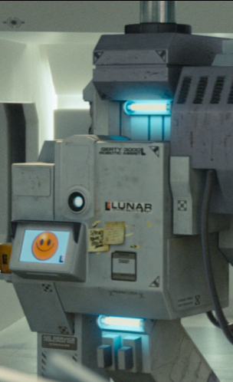
ITP 259: Basics of Artificial Intelligence Fall 2024 Lecture 5: Review of unsupervised machine learning
Dr. Martin Prescher
(other sections & a lot of the material: Prof. Nitin kalÉ) Information technology Program
Viterbi school of engineering
https://www.tafce.com/index.php?title=File:GERTY_3000_-_Edited.png

Slide 2
“I'm here to keep you safe, Sam.”
- GERTY, Moon, 2009

Slide 3
Outline
Machine Learning
Entrance Point (mathematically)
Unsupervised
Clustering
Association Analysis
Supervised
Estimation
Linear Regression
Logistic Regression
Classification
KNN
SVM
Decision Trees
Neural Networks

Slide 4
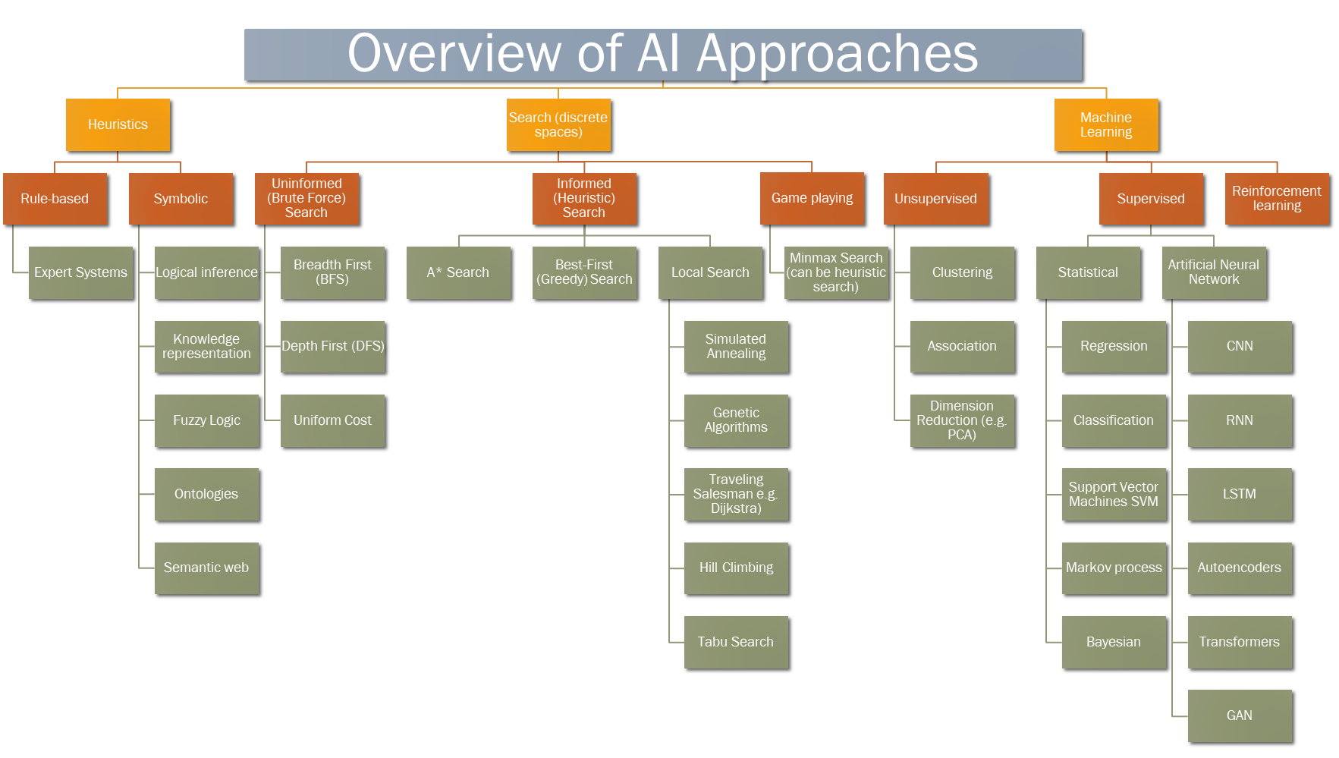

Unsupervised learning
Identifies commonalities (patterns) in a dataset. It attempts to find structure in the data. No human labels the dataset, there is no target response.
Reminder: in supervised learning (e.g. Regression or Neural Networks) we attempt to find a function that approximates the target data from the input data :
In unsupervised learning we want to find structure, patterns, representations in X without a target Y.
We mainly look at 2 methods:
Clustering (k-means)
Association Analysis
$$Y=f\left(X\right)=h_{θ}\left(X\right)$$
Please make sure to not confuse the following pairs:
Clustering and Classification. Clustering is an unsupervised learning technique, Classification is supervised (targets are categories, not real values / numbers)
K-means and K-Nearest-Neighbor (KNN). K-Means is a clustering algorithm, KNN is a Classification algorithm

Slide 5
Unsupervised learning
No target (response) variable
k-means Used to segment members (items) into unique clusters based on a variety of features
Association Analysis: Find rules that show the affinity between items in a set. In a shopping cart, Coffee → Pastry, Medialuna

Slide 6
Clustering
A set of unsupervised algorithms that categorize samples into clusters in which the samples are more similar to each other than the samples outside the cluster.

Slide 7
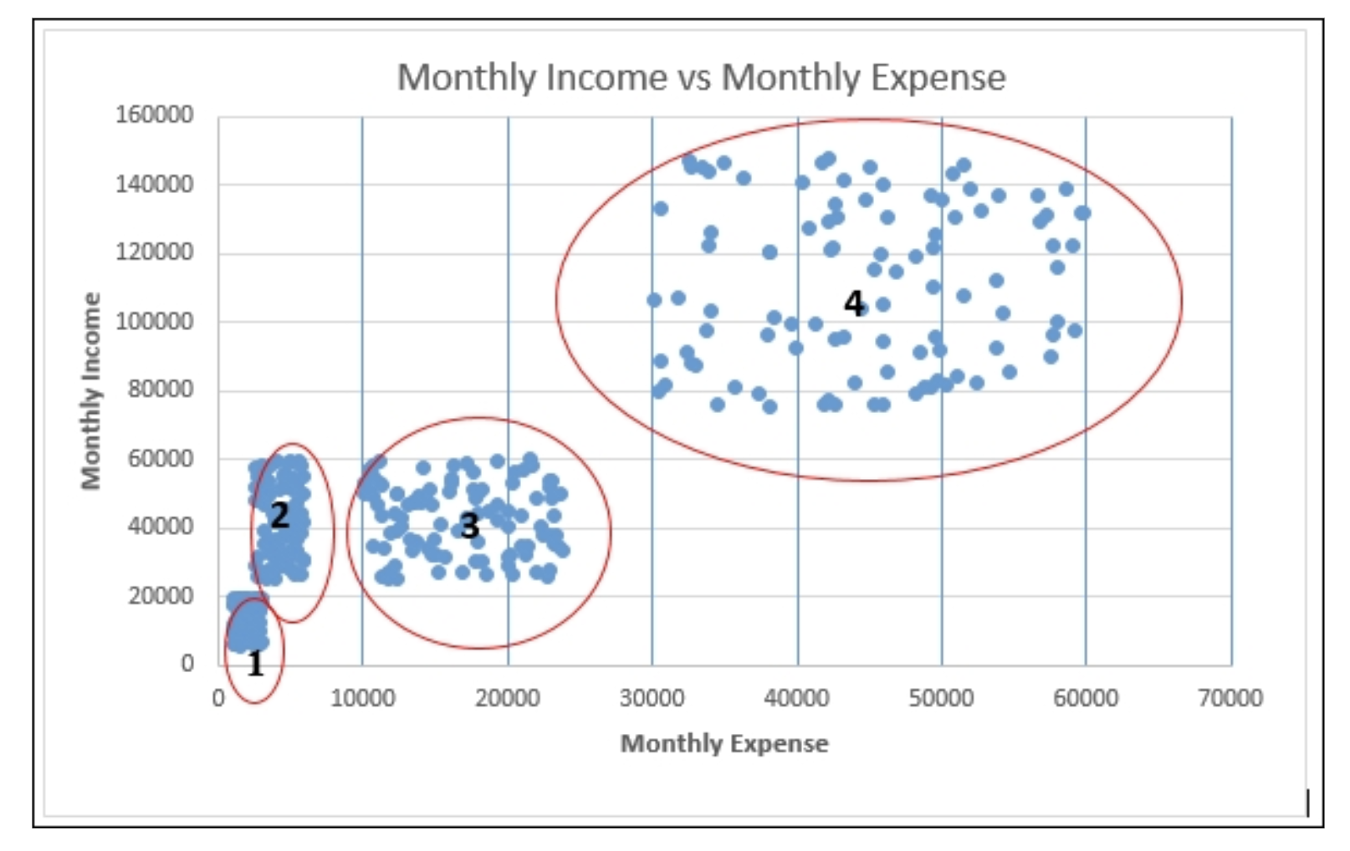
We can identify 4 clusters:
1 - low/low
2 - med/low
3 - med/med
4 - high/high
Clustering reveals that there is a correlation between Monthly Expenses and Monthly Income
Notes:
Customer targeting

Slide 8
Cluster Analysis concept
When we look at the figure, we see many individual objects. Rather than see this as a large collection of individual objects, most people would like to reduce the complexity and get a "simpler" description.
There are several ways to reduce complexity:
One person could say that the figure consists of several diamonds and ovals, thereby reducing the complexity to two.
Other people might seek to reduce the complexity in other ways – the figure consists of "sharp" and "smooth" objects.
E.g. Marketing Application:
In a business context, a company might have thousands of customers and plan to run a promotional campaign. The company could develop a single promotion for all its customers, or a separate promotion customized for each individual customer. Neither approach seems good. The former "one size fits all" approach might not work well for many and end up not satisfying anyone. The latter is impractical. Another possible approach would be to divide the set of customers into a small number of "coherent" groups and develop a campaign for each group.
Of course, we would like the members of each cluster to be as "similar" as possible to each other and quite "distinct" from members of other clusters. The main point is "What do we mean by the term similar?

Slide 9
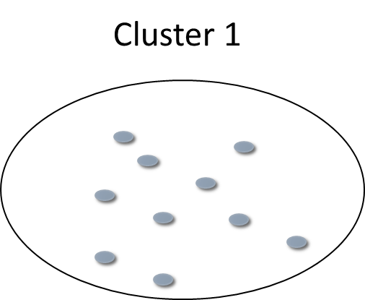
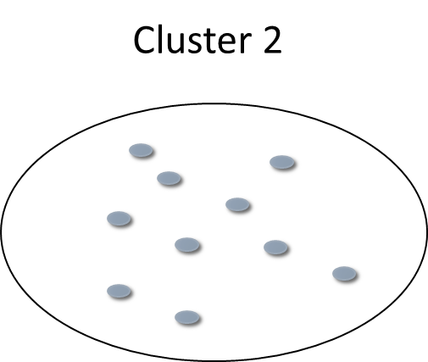
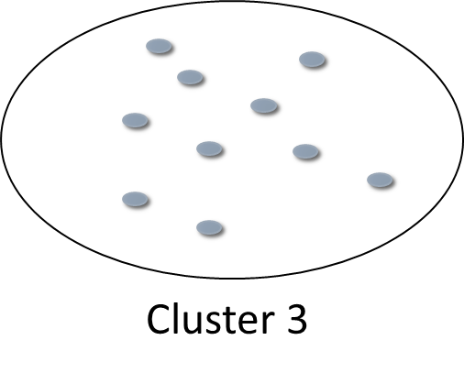
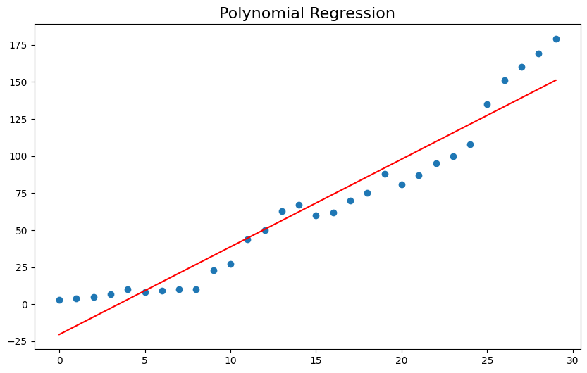


Cases within a cluster are closer to each other than to cases from other clusters
By ‘similar’ we mean:
Excursion: measuring distance in supervised learning
We will get into this in detail in the next lecture on supervised learning.
The overall objective behind ALL learning methods is to build a model f(x) and measure the model accuracy (closeness of the model to the input data x). If we are trying to learn numerical values and we know the targets y, we can measure accuracy by calculating the distance between the input data and the model (in linear regression our model is the straight line):
Generally the Euclidean Distance is used
to measure distance in a physical space like an x-y coordinate system:
We will use Euclidean distance and other
distances measures (also called Norms) in most supervised learning methods such as regression problems.
Distance between our model and the measurements
(x , y) and (x , f(x))
= $\sqrt{{\left(y−f(x\right)}^{2}}=\left|y−f(x)\right|$
Target y
f(x)
$$\sqrt{a^{2}+b^{2}}$$
b
a
For clustering, we do NOT have a target vector and we need to measure closeness in a different way. That is done by calculating the Variance within each cluster (next slide).
Input Data x

Slide 10
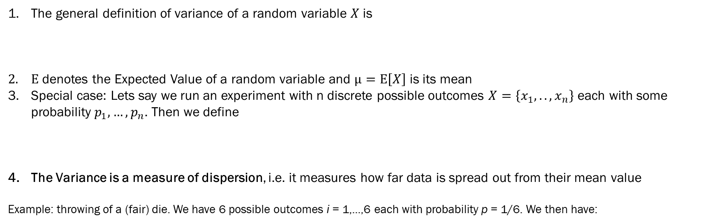
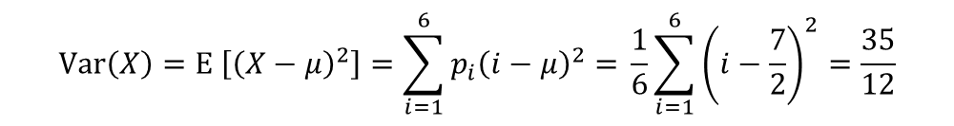
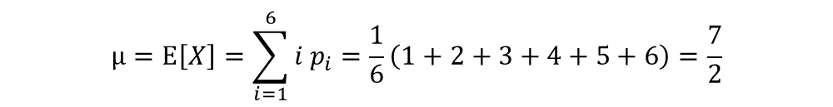
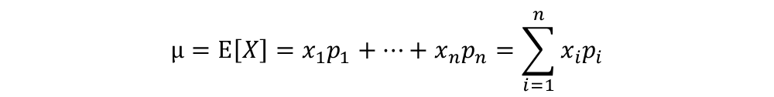
Excursion: Variance and why we need it
What we do for unsupervised clustering is to use statistical methods and look at the Variance within each cluster.
The general definition of variance of a random variable $X$ is
$E$ denotes the Expected Value of a random variable and $μ=E\left[X\right]$ is its mean
Special case: Lets say we run an experiment with n discrete possible outcomes $X=\left\{x_{1},..,x_{n}\right\}$ each with some probability $p_{1},…,p_{n}$. Then we define
The Variance is a measure of dispersion, i.e. it measures how far data is spread out from their mean value
Example: throwing of a (fair) die. We have 6 possible outcomes i = 1,...,6 each with probability p = 1/6. We then have:
$Var\left(X\right)≔E \left[{\left(X−μ\right)}^{2}\right]$ (mean value of the squared deviation from the mean)
$$μ=E\left[X\right]=x_{1}p_{1}+…+x_{n}p_{n}=\sum_{i=1}^{n}{x_{i}p_{i}}$$
$$μ=E\left[X\right]=\sum_{i=1}^{6}{i p_{i}}=\frac{1}{6}\left(1+2+3+4+5+6\right)=\frac{7}{2}$$
$$Var\left(X\right)=E \left[{\left(X−μ\right)}^{2}\right]=\sum_{i=1}^{6}{p_{i}{\left(i−μ\right)}^{2}= }\frac{1}{6}\sum_{i=1}^{6}{{\left(i−\frac{7}{2}\right)}^{2}}=\frac{35}{12}$$

Slide 11
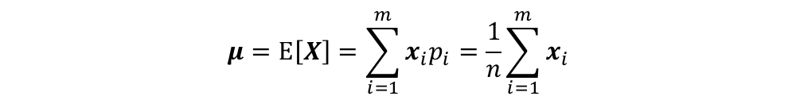
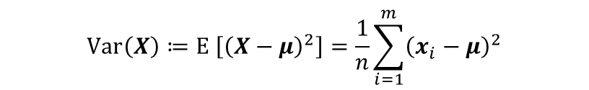


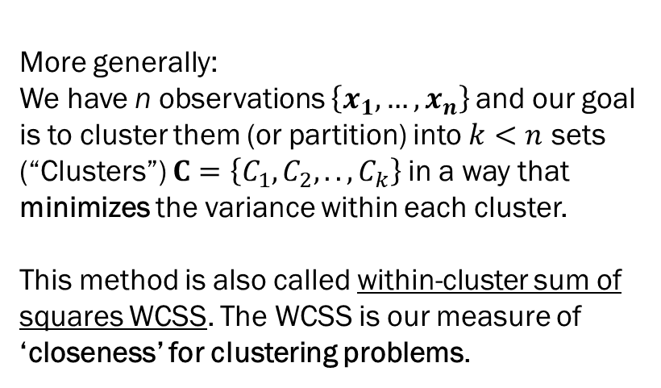
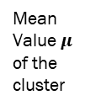
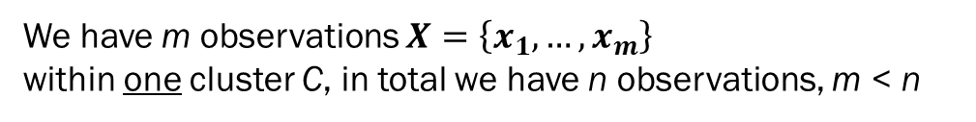
Excursion: Variance and why we need it
$$μ=E\left[X\right]=\sum_{i=1}^{m}{x_{i}p_{i}}=\frac{1}{n}\sum_{i=1}^{m}{x_{i}}$$
We have m observations $X=\left\{x_{1},…,x_{m}\right\}$
within one cluster C, in total we have n observations, m < n
$$Var\left(X\right)≔E \left[{\left(X−μ\right)}^{2}\right]=\frac{1}{n}\sum_{i=1}^{m}{{\left(x_{i}−μ\right)}^{2}}$$
$$x_{i}$$
Variance within 1 cluster of size m
$x_{i}$ - $μ$
More generally:
We have n observations $\left\{x_{1},…,x_{n}\right\}$and our goal is to cluster them (or partition) into $k<n$ sets (“Clusters”) $C=\left\{C_{1},C_{2},..,C_{k}\right\}$in a way that minimizes the variance within each cluster.
This method is also called within-cluster sum of squares WCSS. The WCSS is our measure of ‘closeness’ for clustering problems.
Mean Value $μ$ of the cluster

Slide 12
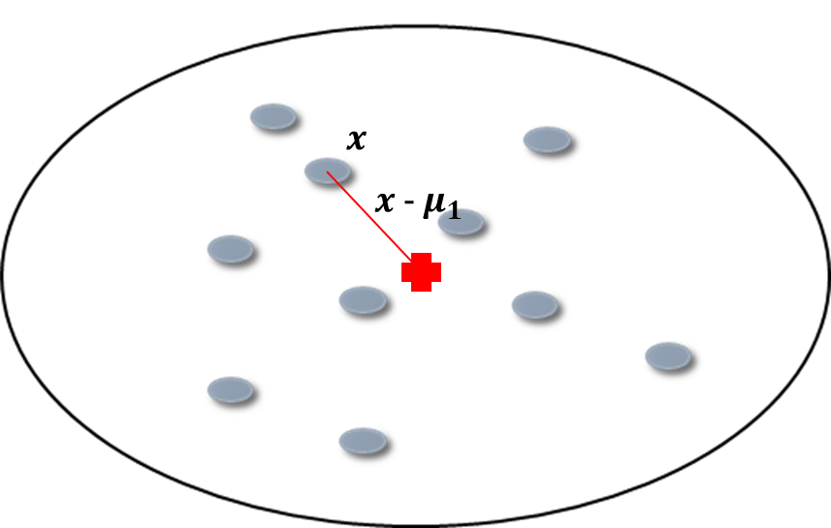


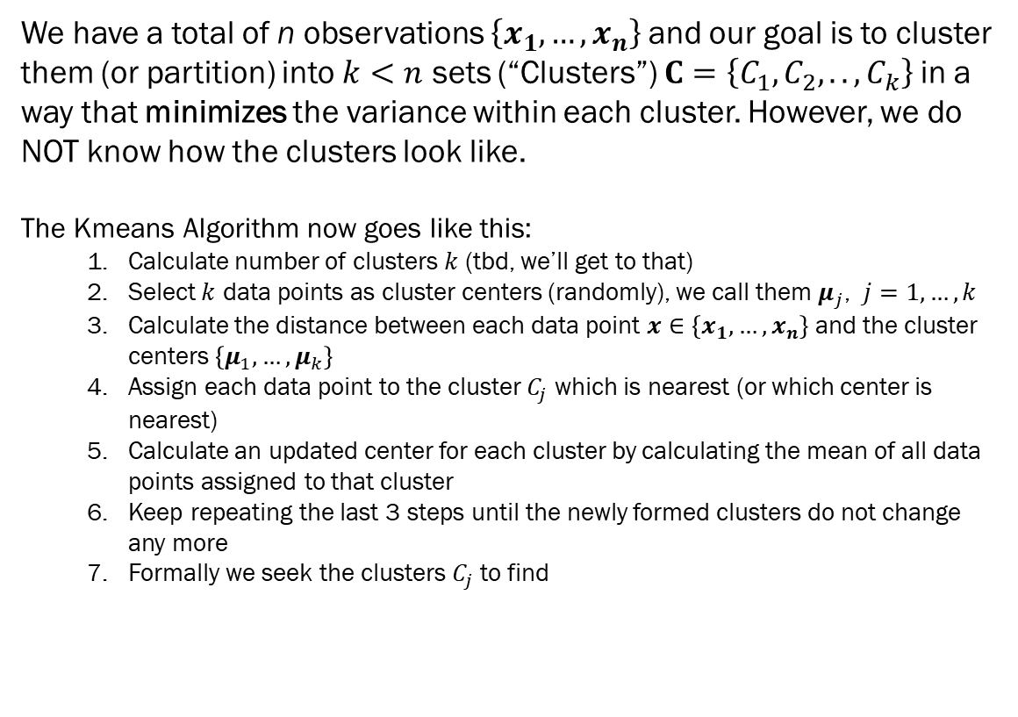



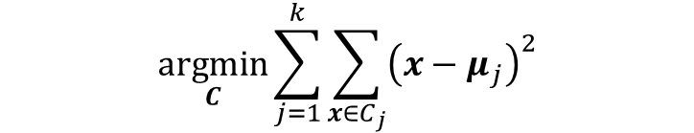
And now the kmeans Algorithm
We have a total of n observations $\left\{x_{1},…,x_{n}\right\}$and our goal is to cluster them (or partition) into $k<n$ sets (“Clusters”) $C=\left\{C_{1},C_{2},..,C_{k}\right\}$in a way that minimizes the variance within each cluster. However, we do NOT know how the clusters look like.
The Kmeans Algorithm now goes like this:
Calculate number of clusters $k$ (tbd, we’ll get to that)
Select $k$ data points as cluster centers (randomly), we call them $μ_{j}$, $j=1,…,k$
Calculate the distance between each data point $x∈\left\{x_{1},…,x_{n}\right\}$and the cluster centers $\left\{μ_{1},…,μ_{k}\right\}$
Assign each data point to the cluster $C_{j}$ which is nearest (or which center is nearest)
Calculate an updated center for each cluster by calculating the mean of all data points assigned to that cluster
Keep repeating the last 3 steps until the newly formed clusters do not change any more
Formally we seek the clusters $C_{j}$ to find
$$C_{1}$$
$$C_{2}$$
$$\underset{C}{argmin}{\sum_{j=1}^{k}{\sum_{x∈C_{j}}{{\left(x−μ_{j}\right)}^{2}}}}$$
$$C_{k}$$

Slide 13
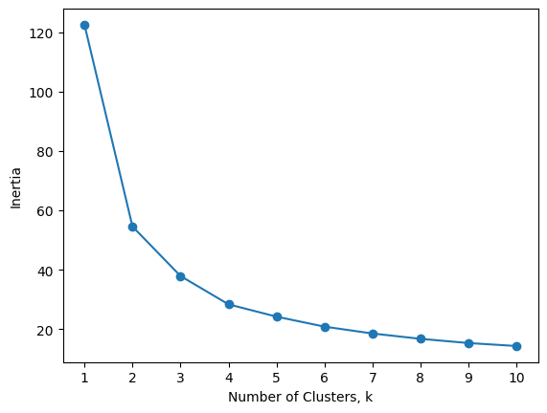
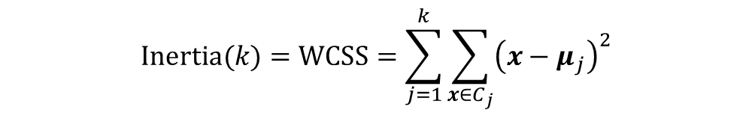
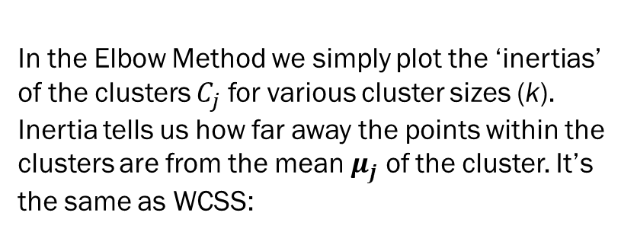
Now a hard problem: How to determine k
Method 1: Elbow Method
In the Elbow Method we simply plot the ‘inertias’ of the clusters $C_{j}$ for various cluster sizes (k). Inertia tells us how far away the points within the clusters are from the mean $μ_{j}$ of the cluster. It’s the same as WCSS:
$$Inertia(k)=WCSS=\sum_{j=1}^{k}{\sum_{x∈C_{j}}{{\left(x−μ_{j}\right)}^{2}}}$$
See Colab / .py file

Slide 14
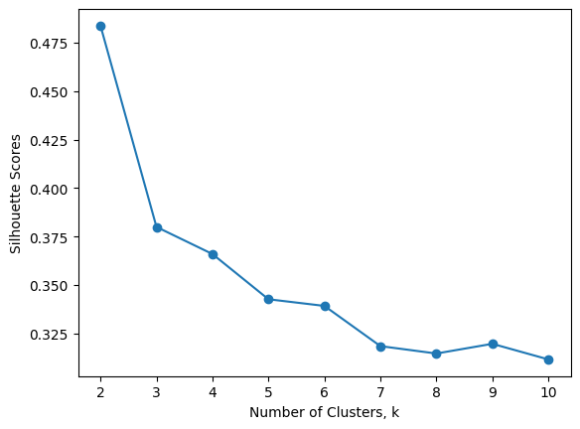
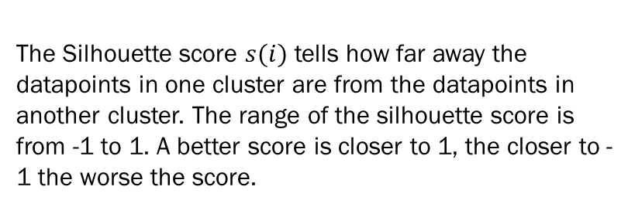

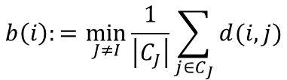
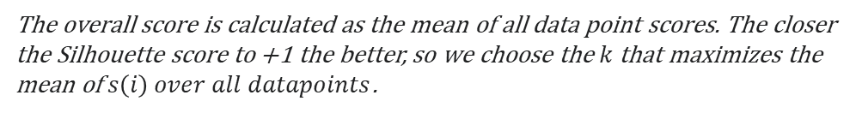
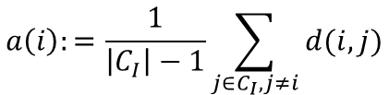
See Colab / .py file
Now a hard problem: How to determine k
Method 2: Silhouette Method
The Silhouette score $s(i)$ tells how far away the datapoints in one cluster are from the datapoints in another cluster. The range of the silhouette score is from -1 to 1. A better score is closer to 1, the closer to -1 the worse the score.
For a data point $i∈C_{I}$
think Euclidean Distance
These scores are not very good….
$$a\left(i\right):=\frac{1}{\left|C_{I}\right|−1}\sum_{j∈C_{I},j≠i}{d(i,j)}$$
$$b\left(i\right):=\min_{J≠I}{\frac{1}{\left|C_{J}\right|}\sum_{j∈C_{J}}{d(i,j)}}$$
$a\left(i\right)$ is the average intra-cluster distance i.e the average distance between each point within a cluster. The smaller the better.
$b\left(i\right)$ smallest average inter-cluster distance i.e the average distance between all clusters. The larger the better.
$$s\left(i\right):=\frac{b\left(i\right)−a(i)}{\text{max}\left\{a\left(i\right),b(i)\right\}}$$
The overall score is calculated as the mean of all data point scores. The closer the Silhouette score to +1 the better, so we choose the $k$ that maximizes the mean of $s\left(i\right) over all datapoints$.

Slide 15
Finding k is a balance act
Reduce
Complexity
Retain
Diversity

Slide 16
Complexity
Diversity
Number of clusters
Variability

Slide 17
Demo: Wine clustering

Slide 18
Do this:
Read the wine dataset. Drop the Wine column.
Print the dataframe.

Slide 19
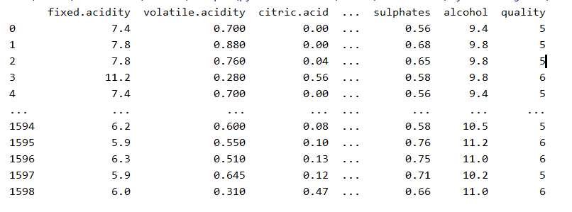

Slide 20
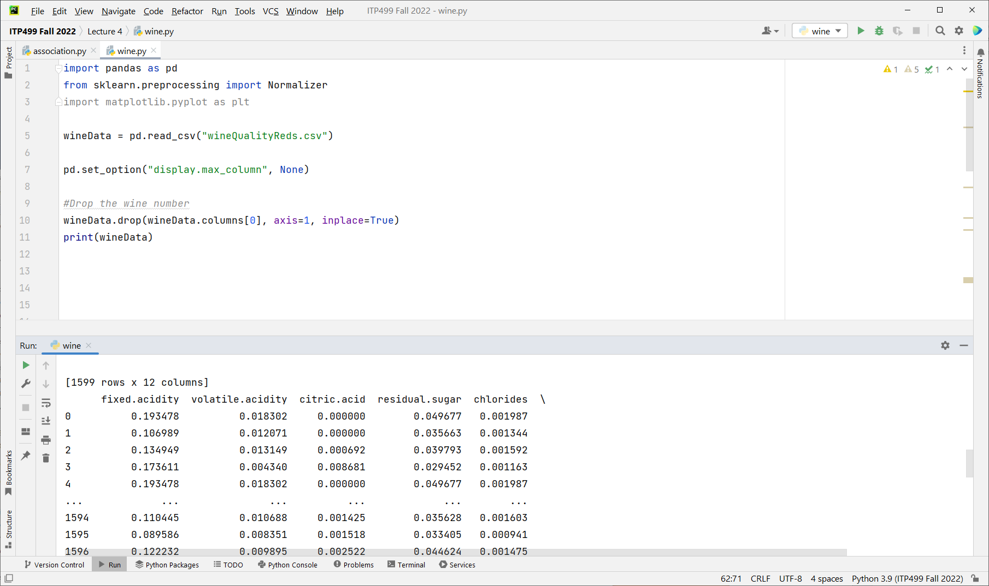

Slide 21
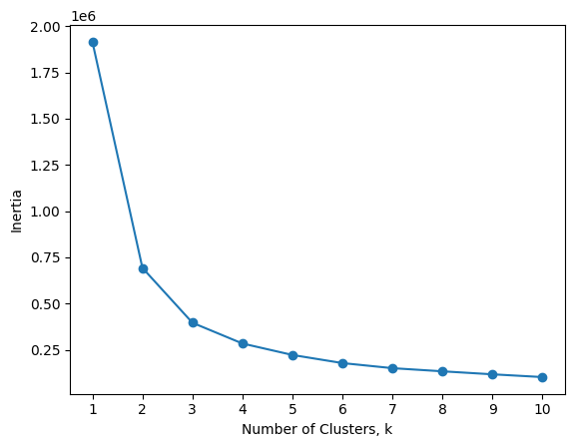

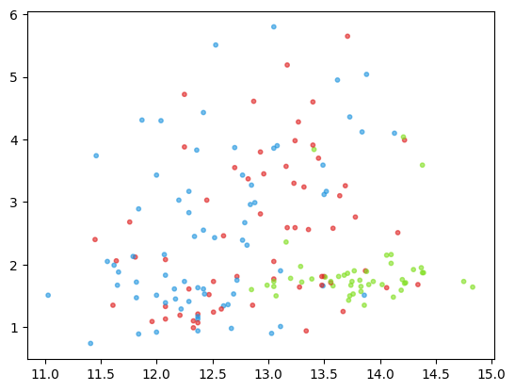
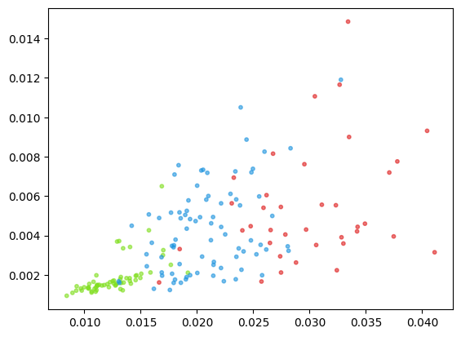

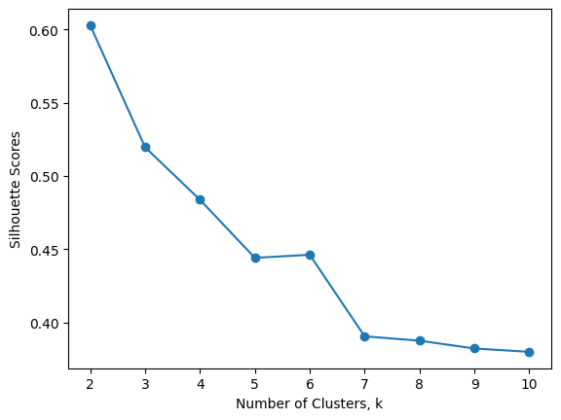
Feature Scaling
As we saw earlier the computation to determine k and the k-mean algorithm itself involve the summation of squared deviations from the cluster centers. If features have very different scales (same being on the scale between 5 and 11 like fixed.acidity and some being on the 0.01 scale like chlorides) the higher-scale features will affect the results disproportionally more than the others.
Feature scaling through standardization (sometimes called Z-score normalization) is an important preprocessing step for many machine learning algorithms. It involves rescaling each feature such that it has a standard deviation of 1 and a mean of 0.
We can achieve completely different model fit and different evaluations of k
without scaling
with scaling
without scaling
with scaling
without scaling
with scaling

Slide 22
Do this:
We transform each factor (column):
Scale to 0:1 (use Normalizer from sklearn)
Or Standardize it to have a mean of 0 and variance of 1 (use StandardScaler)
Normalize the columns.

Slide 23
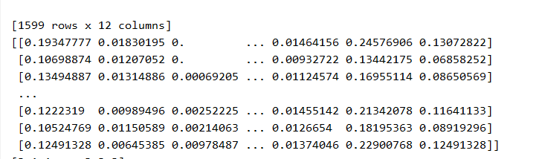

Slide 24
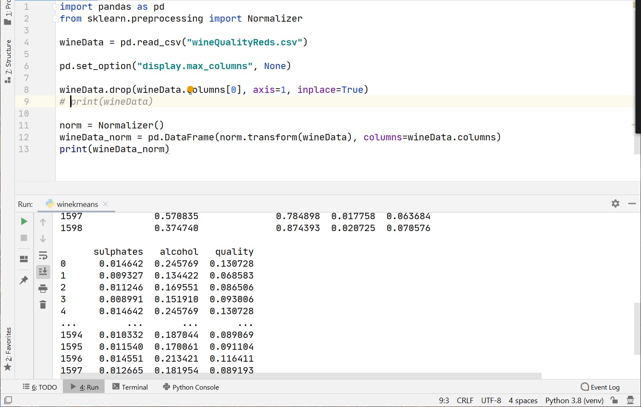

Slide 25
Do this:
Plot the inertia (within-cluster sum of squares) as a function of the number of clusters.
We want to find the optimum number of clusters.

Slide 26
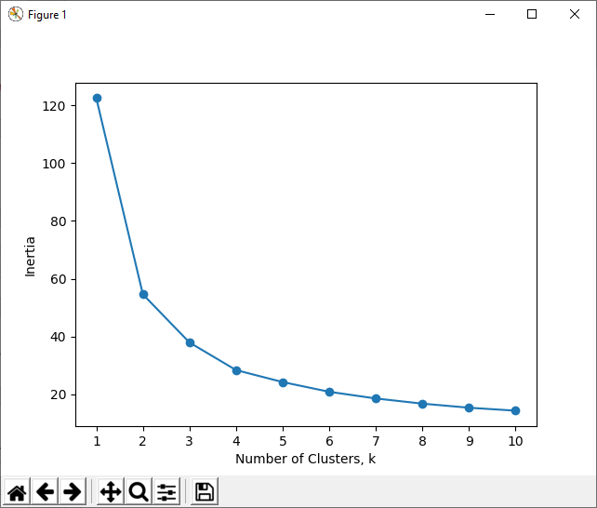

Slide 27
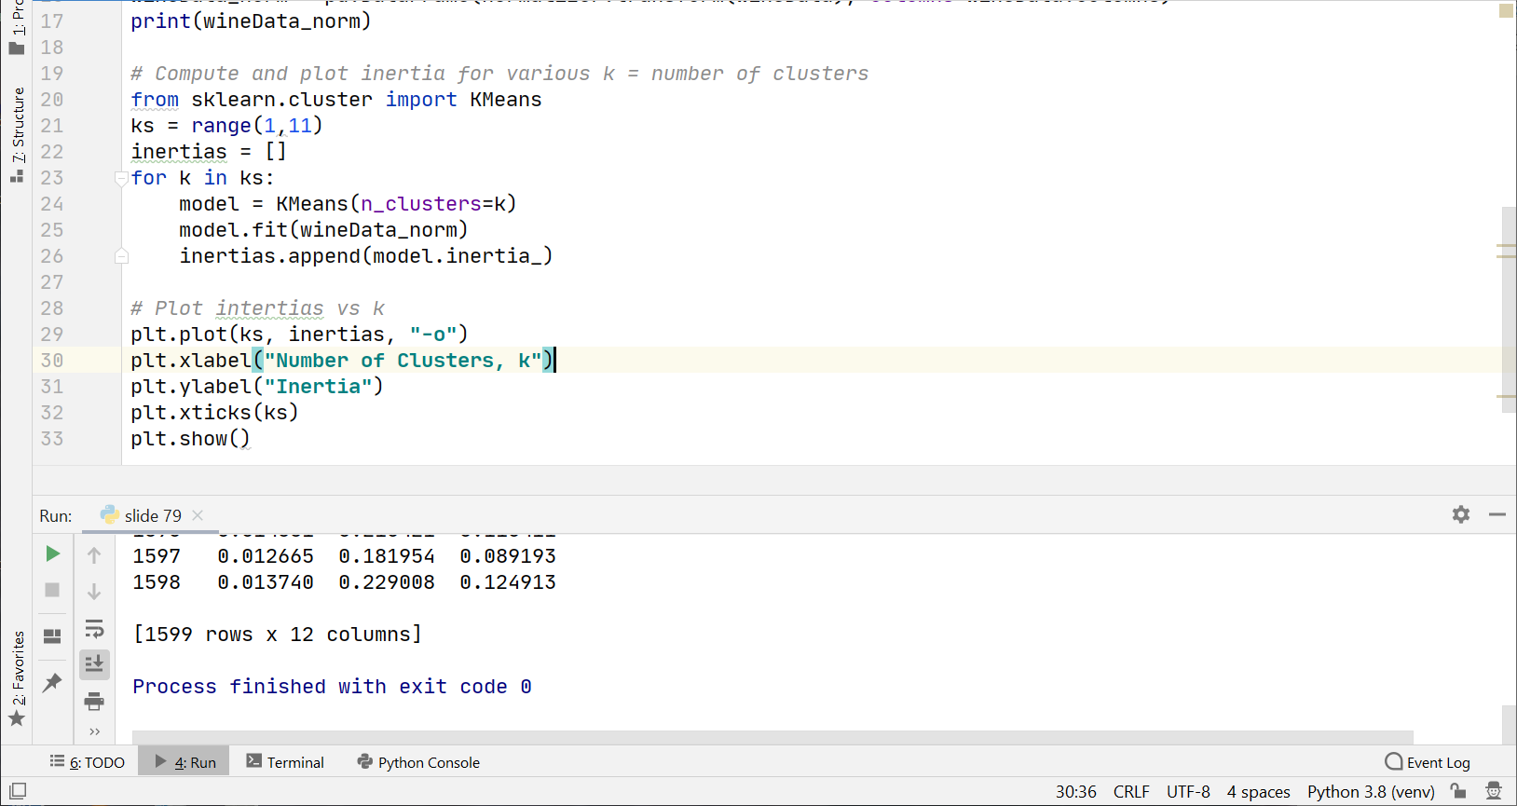

Slide 28
Do this:
Create a K-means model with 6 clusters.
Fit the model to the wine data.
Print the labels.
Add labels to wine data.

Slide 29
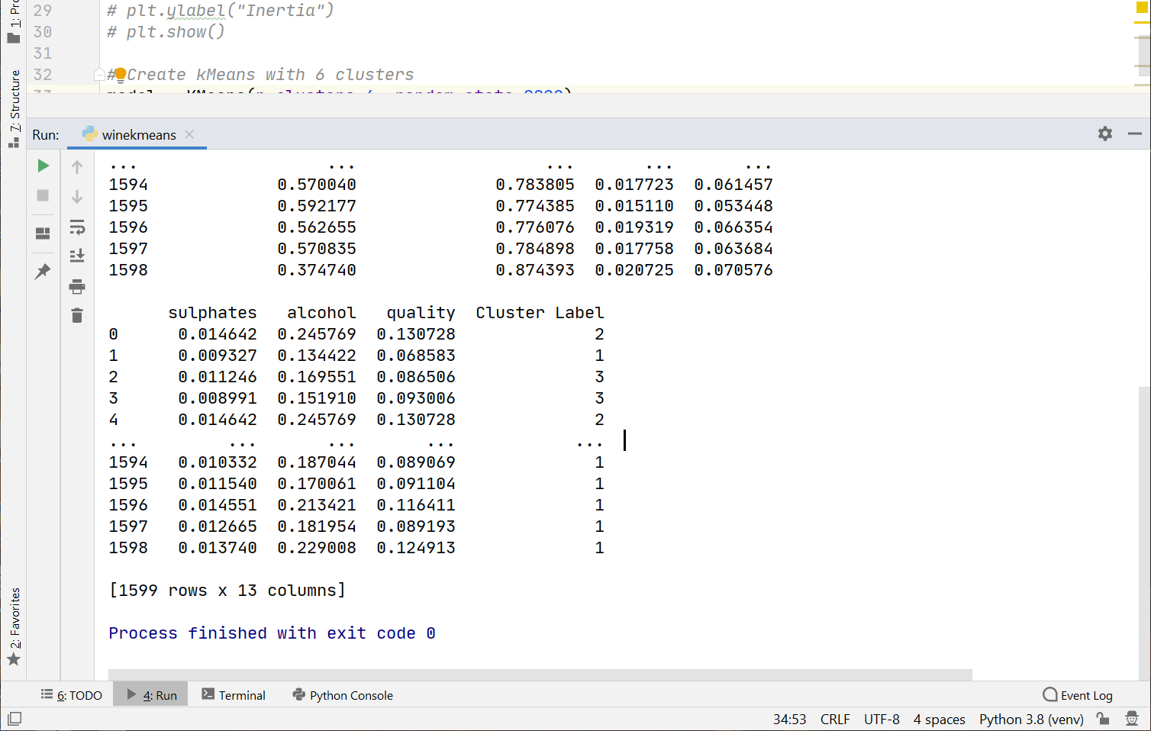

Slide 30
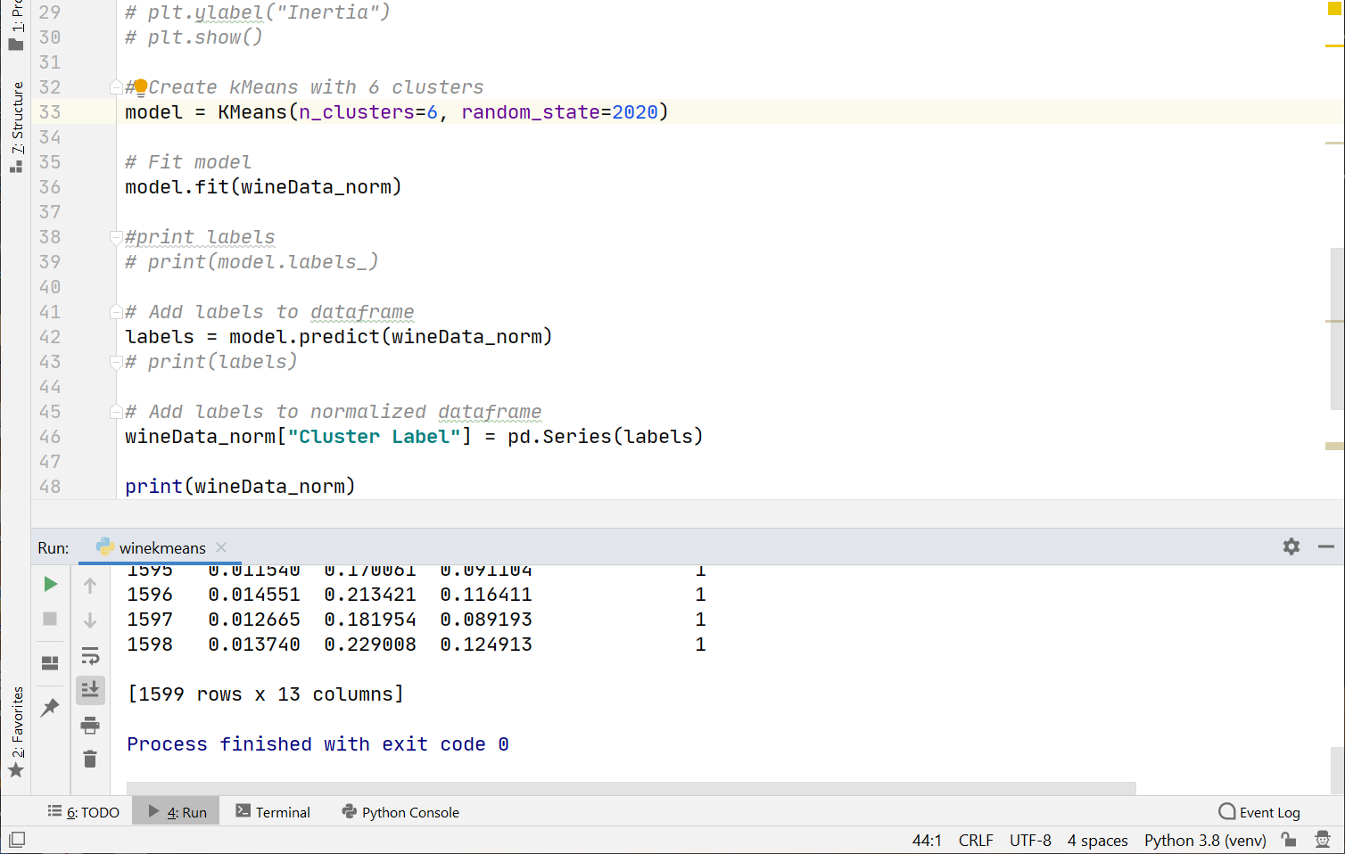
We now have six wine clusters. Every
Wine has been put into one of six clusters.
The wines within a cluster are similar to others.
They are dissimilar to other clustered wines.

Slide 31
Summary
We discussed unsupervised machine learning
Clustering is a mainstay of unsupervised machine learning where data are grouped into clusters
K-means is one algorithm for doing clustering
The result of clustering is that we now have clusters of data (wines). Wines within the same group have similar properties. We could use this information to label the cluster, price the product, market similar wines to customers etc.

